Slide 1

YWHO’s My Wellness Passport Coaching Series
Part 1:
Data cleaning and Common Errors
July 2022

Slide 2
Agenda
Meet the MWP Team
Improving Data Quality
Common MWP Errors
Q&A

Slide 3




Meet the MWP Team
Mary Hanna
Project Manager
Elissa Pendergast
IT/DS Analyst aka
The Helpdesk Person
Nirupa Varatharasan
Evaluator
Priyanka Sharma
Evaluator

Slide 4




Meet the MWP Team
Susan Le
Evaluator
Kathryn Sadowski
Evaluator
Deb Chiodo
Director, Data Management and Evaluation, YWHO PO
Janis Wolfe
Clinical Consultant

Slide 5

Improving Data Quality
End of Visit Form – “Other” field

Slide 6
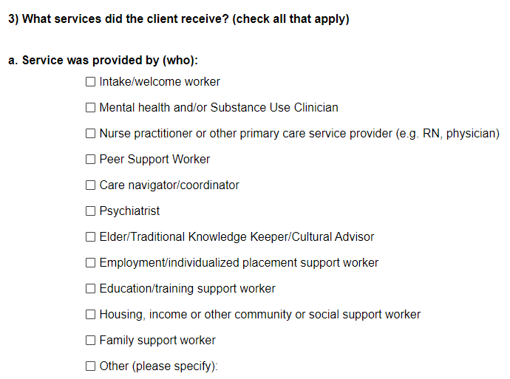
End of Visit – “Other” Field
For Both Questions:
3. What services did the client receive (check all that apply):
Service was provided by (who):

Slide 7
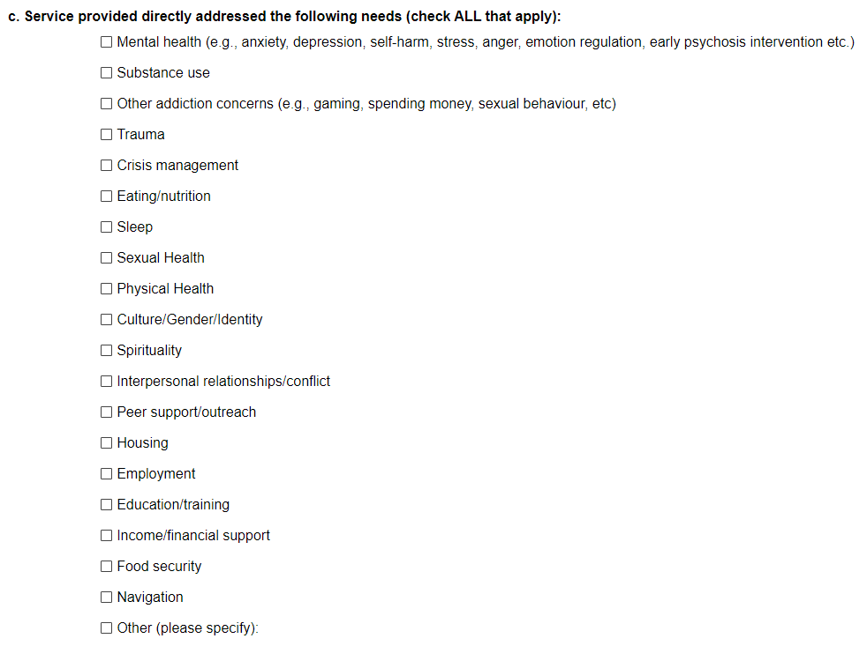
End of Visit – “Other” Field
For Both Questions:
3. What services did the client receive (check all that apply):
c) Service provided directly addresses the following needs (check all that apply):

Slide 8
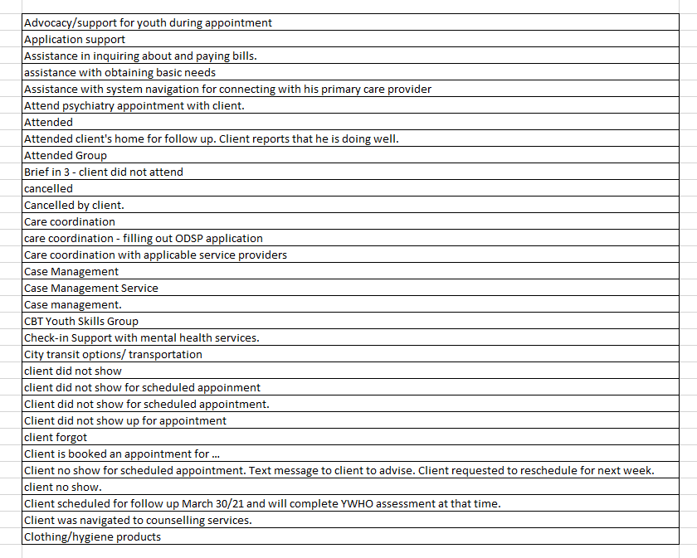
End of Visit – “Other” Field
For Both Questions:
The Other field is overused, often with much better options to be selected

Slide 9
End of Visit – “Other” Field
Examples of responses:
Attended/Attended group
  We need to know what kind of group

Slide 10
End of Visit – “Other” Field
Examples of responses:
1. Attended/Attended group
  We need to know what kind of group
3. What services did the client receive (check all that apply):
Service was provided by (who):
  Was it with a mental health and/or Substance Use Clinician or?

Slide 11
End of Visit – “Other” Field
Examples of responses:
1. Attended/Attended group
  We need to know what kind of group
3. What services did the client receive (check all that apply):
c) Service provided directly addresses the following needs (check all that apply):
What kind of visit/program/group did the youth attend?

Slide 12
End of Visit – “Other” Field
Examples of responses:
2. Care Coordination
  What staff/provided supported this youth?
  What kind of services were provided?

Slide 13
End of Visit – “Other” Field
Examples of responses:
2. Care Coordination
  What staff/provided supported this youth?
  What kind of services were provided?
3. What services did the client receive (check all that apply):
Service was provided by (who):
  Was it with a mental health and/or Substance Use Clinician or?

Slide 14
End of Visit – “Other” Field
Examples of responses:
2. Care Coordination
  What staff/provided supported this youth?
  What kind of services were provided?
3. What services did the client receive (check all that apply):
c) Service provided directly addresses the following needs (check all that apply):
What kind of visit/program/group did the youth attend?

Slide 15
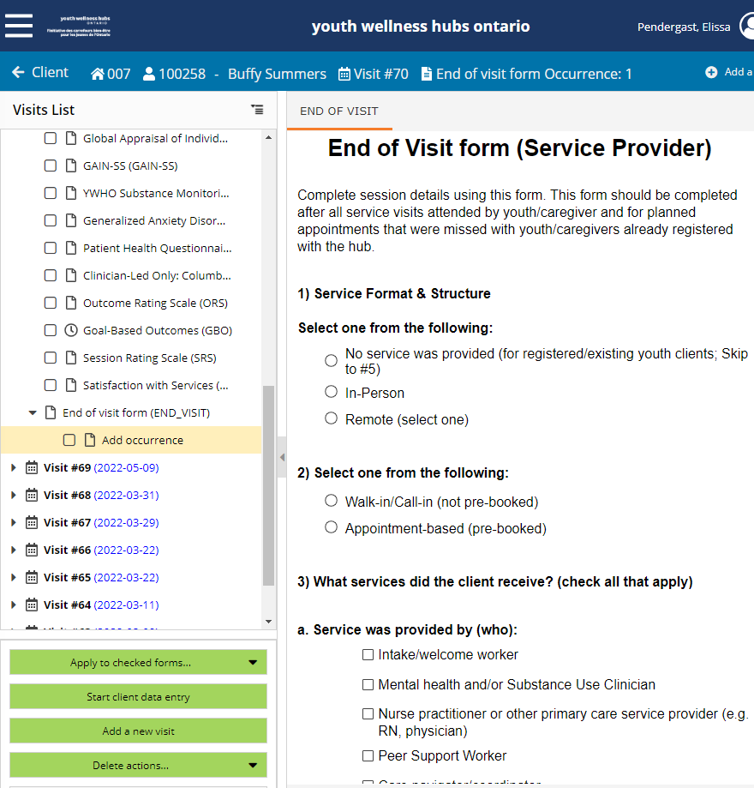
End of Visit – “Other” Field
For Both Questions:
October 2022 – we will be changing the “other” field to optional comments that are not associated with the response options
3. What services did the client receive (check all that apply):
Service was provided by (who):
&
c) Service provided directly addresses the following needs (check all that apply):

Slide 16
End of Visit – “Other” Field
For Both Questions:
October 2022 – we will be changing the “other” field to optional comments that are not associated with the response options
Please review with your team and provide any feedback to mwp@ywho.ca if there are any service providers or services not listed that are offered within your hub in the EOV form

Slide 17
Improving Data Quality
End of Visit Form – “Other” field
Test Clients

Slide 18
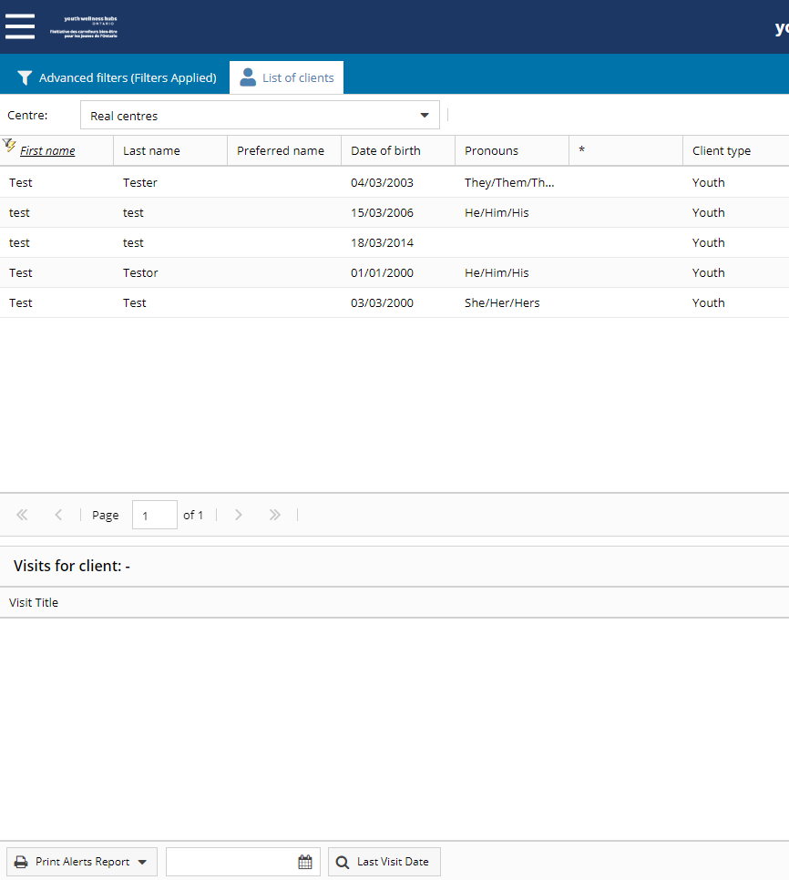
Test Clients
Test clients in your centres can impact the accuracy of your data

Slide 19
Test Clients
Please do not use your real database when practicing in My Wellness Passport
Use our test accounts to practice!

Slide 20
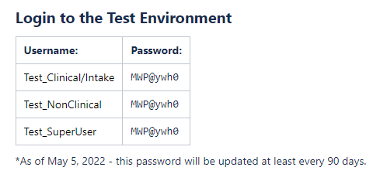
Test Clients
To practice deleting clients, visits and forms, use the test environments to practice
Please note only
Test_SuperUser
has access to delete data

Slide 21
Test Clients
Now, let’s learn how to delete these test clients
Can you think of any test client names you have entered into your database?

Slide 22
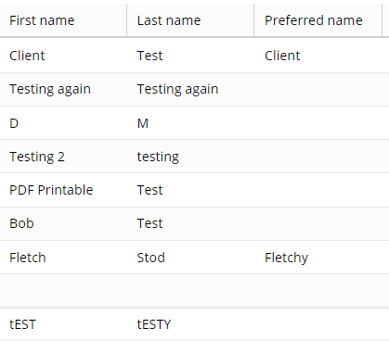
Test Clients
Now, let’s learn how to delete these test clients
Common test names used in MWP include but are not limited to:
  Jane/John Doe
  Test
  ABC or 123

Slide 23
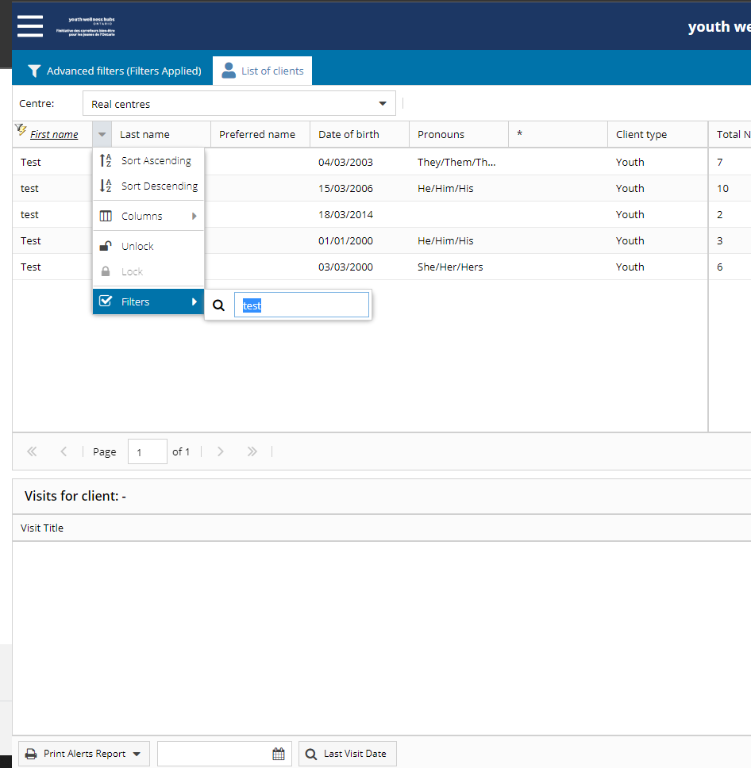
Test Clients
Test clients in your centres can impact your data
It is important to check/search fields from the:
  First name
  Last name
  Preferred name

Slide 24
Test Clients
Only SuperUsers have access to delete (test) clients
Either request an admin/manager to do this

Slide 25
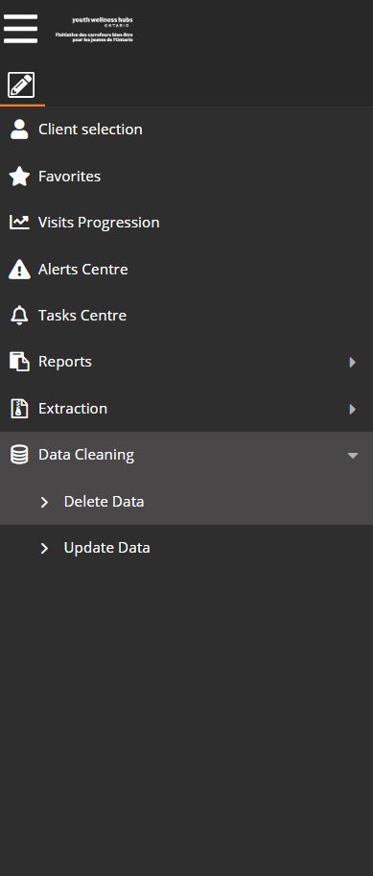
Test Clients
Only SuperUsers have access to delete (test) clients
Either request your hub’s admin/manager to do this if you do not have access

Slide 26
Test Clients
For SuperUsers to do this, log into MWP using your personal login credentials
In the top left corner, select Data Cleaning, and then Delete Data

Slide 27
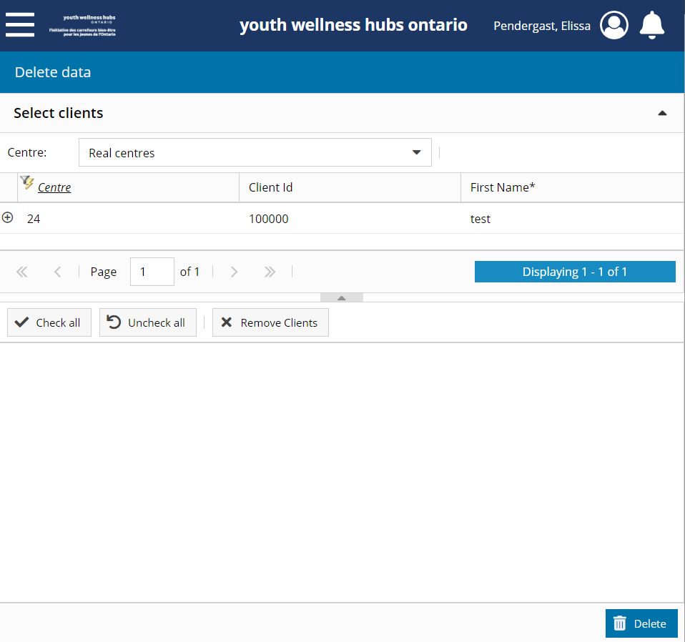
Test Clients
Find your client, and double click on the row

Slide 28
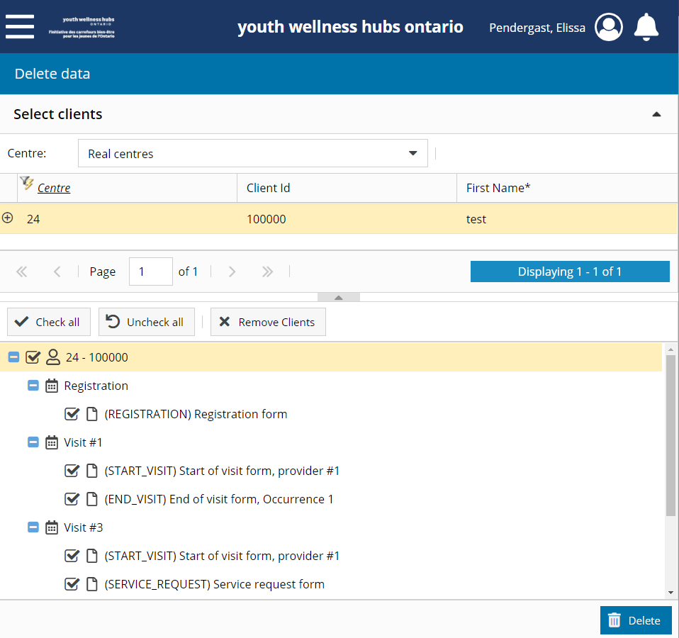
Test Clients
Find your client, and double click on the row
Select all of the boxes for that client

Slide 29
Test Clients
Find your client, and double click on the row
Select all of the boxes for that client
In the bottom right corner, select “Delete”
Here you will be asked to enter in your personal login credentials

Slide 30

Test Clients
One you delete a client, you cannot retrieve this client again in My Wellness Passport
All of their data will be gone, so ensure you are selecting the correct client and/or forms

Slide 31
Improving Data Quality
End of Visit Form – “Other” field
Test Clients
Blank Visits

Slide 32
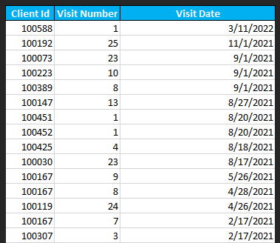
Blank Visits
Quarterly, the YWHO PO evaluation team will generate a list for your hub to review if the visits happened, and if so, to complete forms

Slide 33
Blank Visits
Only SuperUsers have access to delete visits and forms
Either request your hub’s admin/manager to do this if you do not have access

Slide 34
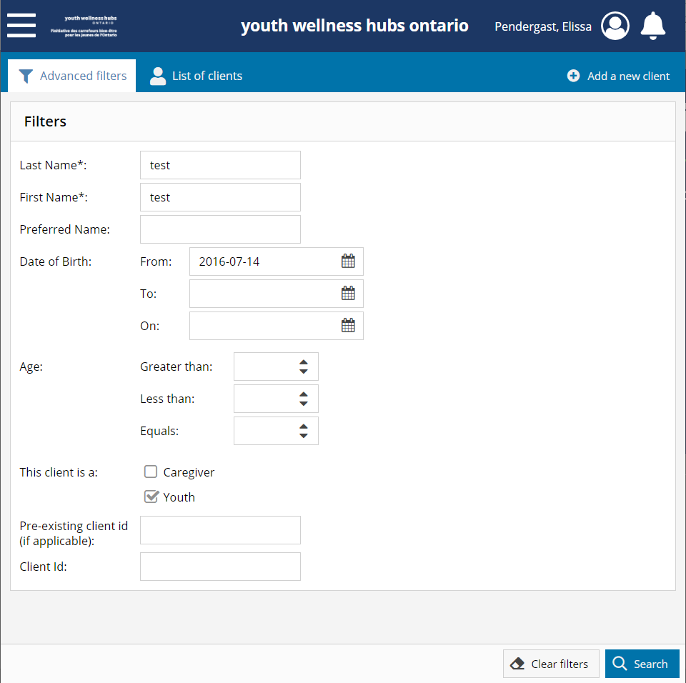
Blank Visits
For SuperUsers to do this, log into MWP using your personal login credentials
First, search for youth by last name, first name, and Date of Birth

Slide 35
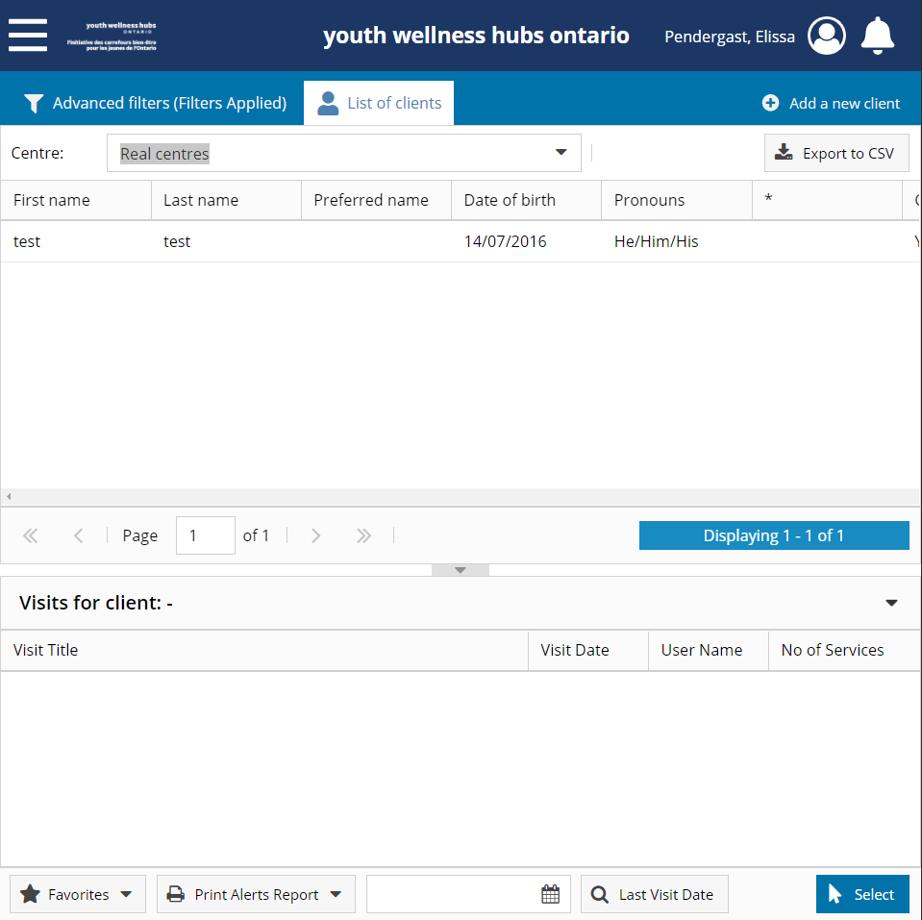
Blank Visits
Find your client, and double click on the row

Slide 36
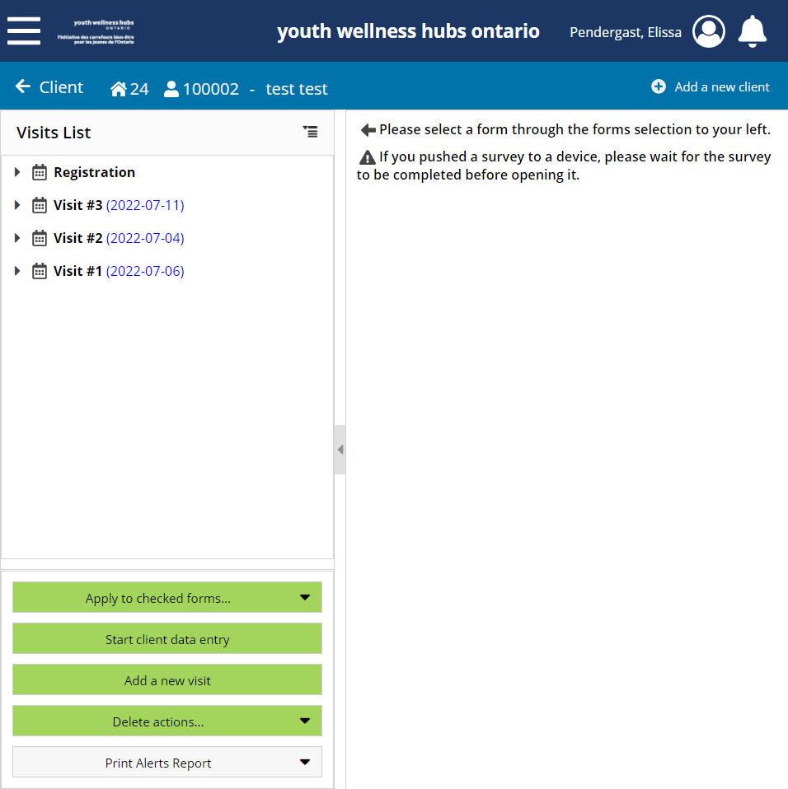
Blank Visits
In the bottom left corner, you will see the button, “Delete actions…”

Slide 37
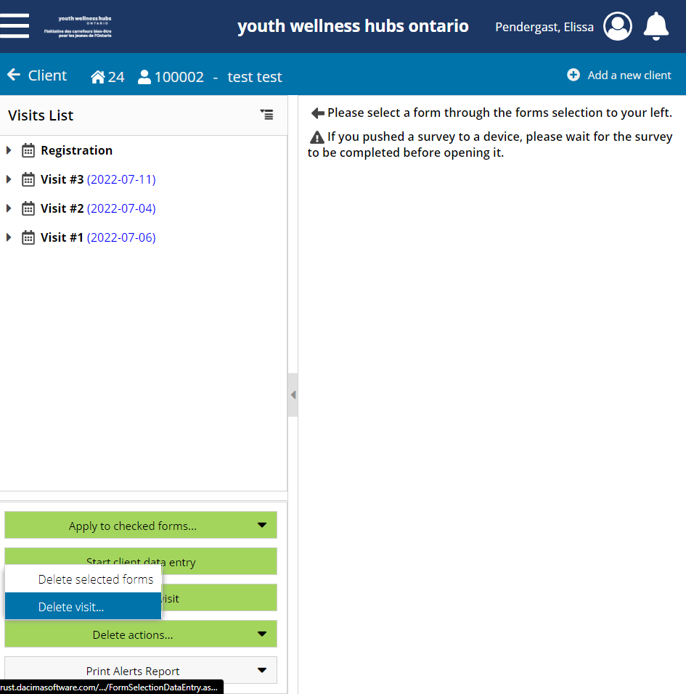
Blank Visits
In the bottom left corner, you will see the button, “Delete actions…”

Slide 38
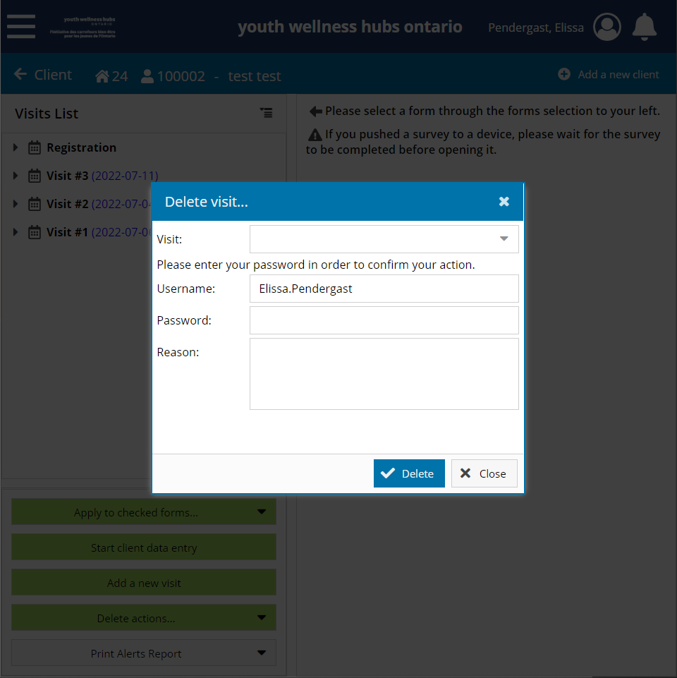
Blank Visits
In the bottom left corner, you will see the button, “Delete actions…”

Slide 39

Blank Visits
Select the Visit you would like to delete, enter in your password, and the reason why you are deleting this visit

Slide 40
Blank Visits
Select the Visit you would like to delete, enter in your password, and the reason why you are deleting this visit

Slide 41
Blank Visits
Once you delete a form or visit, you cannot retrieve this information again in My Wellness Passport
The data will be permanently deleted, so ensure you are selecting the correct client and/or forms

Slide 42
Improving Data Quality
End of Visit Form – “Other” field
Test Clients
Blank Visits
Empty DOBs

Slide 43
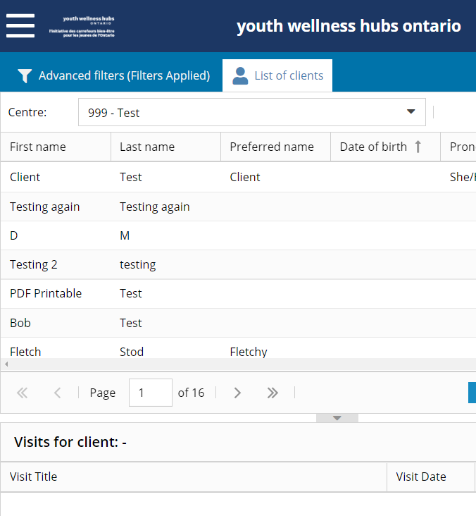
Youth Profiles without DOBs
As you can see here in the test data, many youth are listed without DOB’s
We see this sometimes in real data

Slide 44
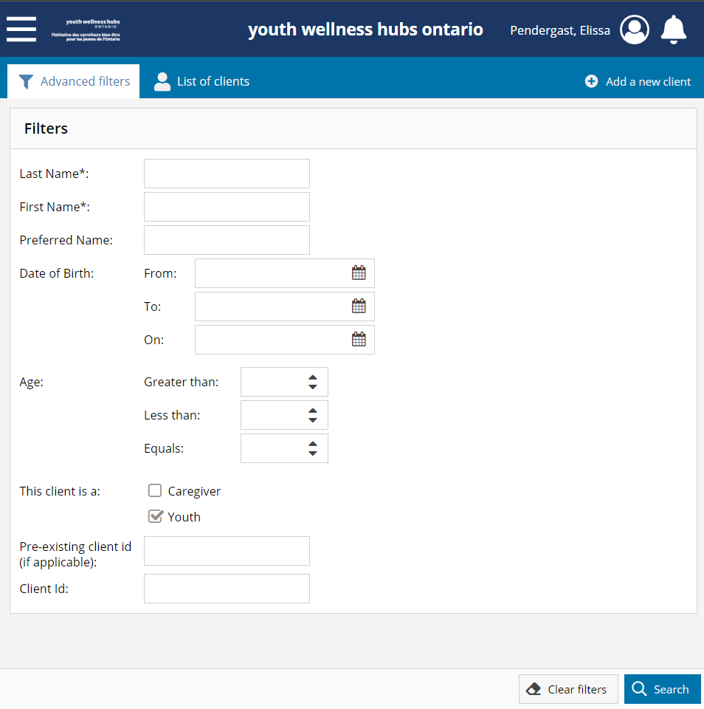
Youth Profiles without DOBs
To find youth profiles without Date of Births, admins/managers can search all of their clients by:
  Selecting only “Youth”

Slide 45
Youth Profiles without DOBs
To find youth profiles without Date of Births, admins/managers can search all of their clients by:
  Selecting only “Youth”
  Selecting “Search”

Slide 46
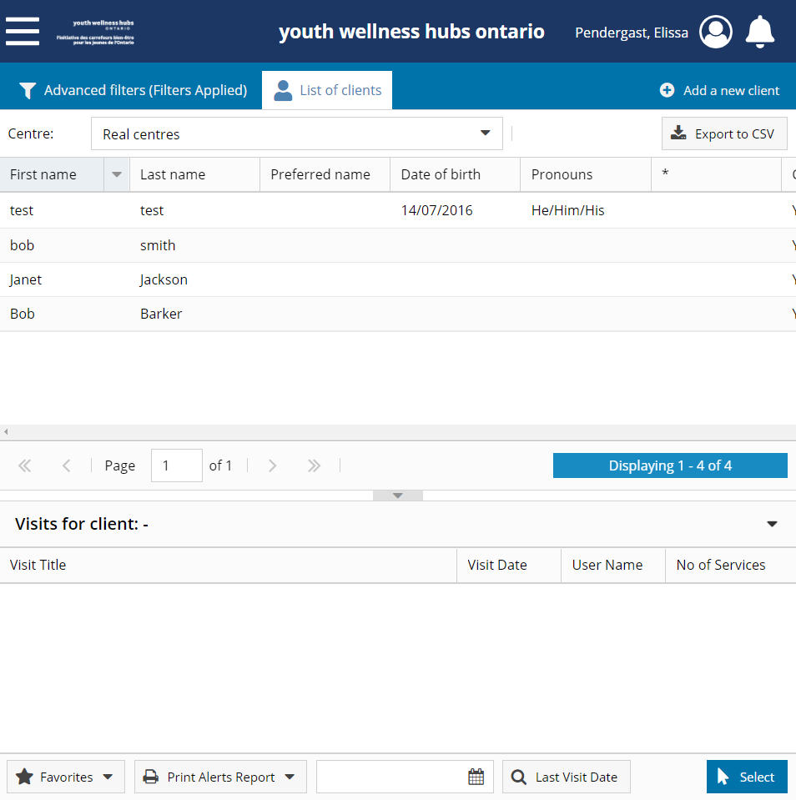
Youth Profiles without DOBs
Here you will see all the youth listed in your Hub’s centre in MWP
You can see three youth profiles are do not have DOBs

Slide 47
Youth Profiles without DOBs
To add a DOB on a youth profile, double click on the line of the youth’s profile

Slide 48
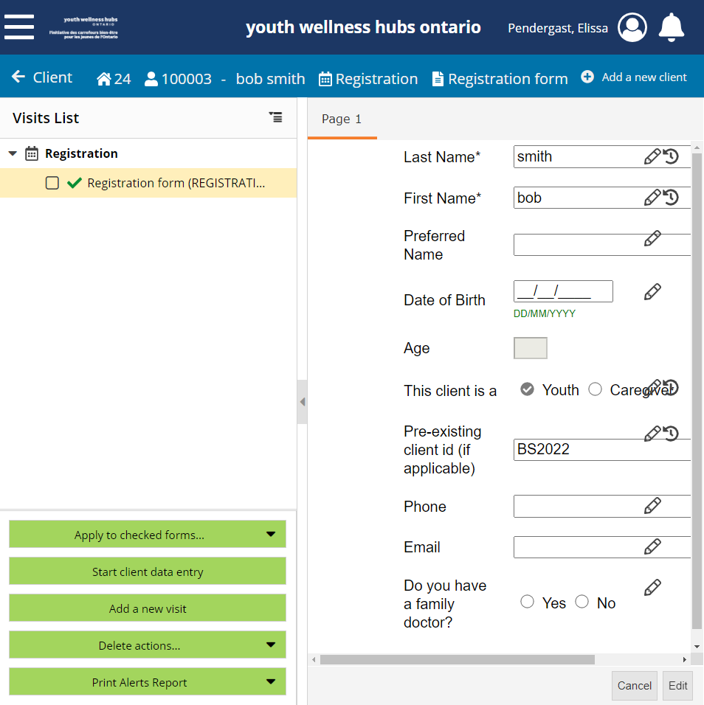
Youth Profiles without DOBs
As you can see here, someone entered that Bob Smith had a different client ID, that you can cross reference a different database to obtain the youth’s DOB

Slide 49
Improving Data Quality
End of Visit Form – “Other” field
Test Clients
Blank Visits
Empty DOBs
Missing Start of Visit Forms

Slide 50
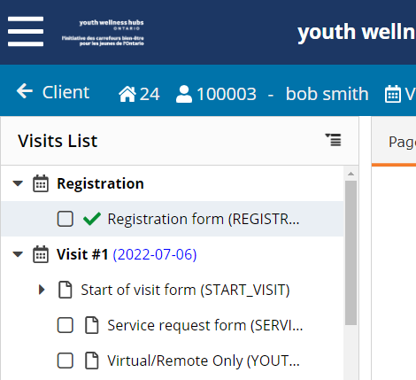
Start of Visit Forms
The Start of Visit form allows the assignment of the visit to one provider.

Slide 51
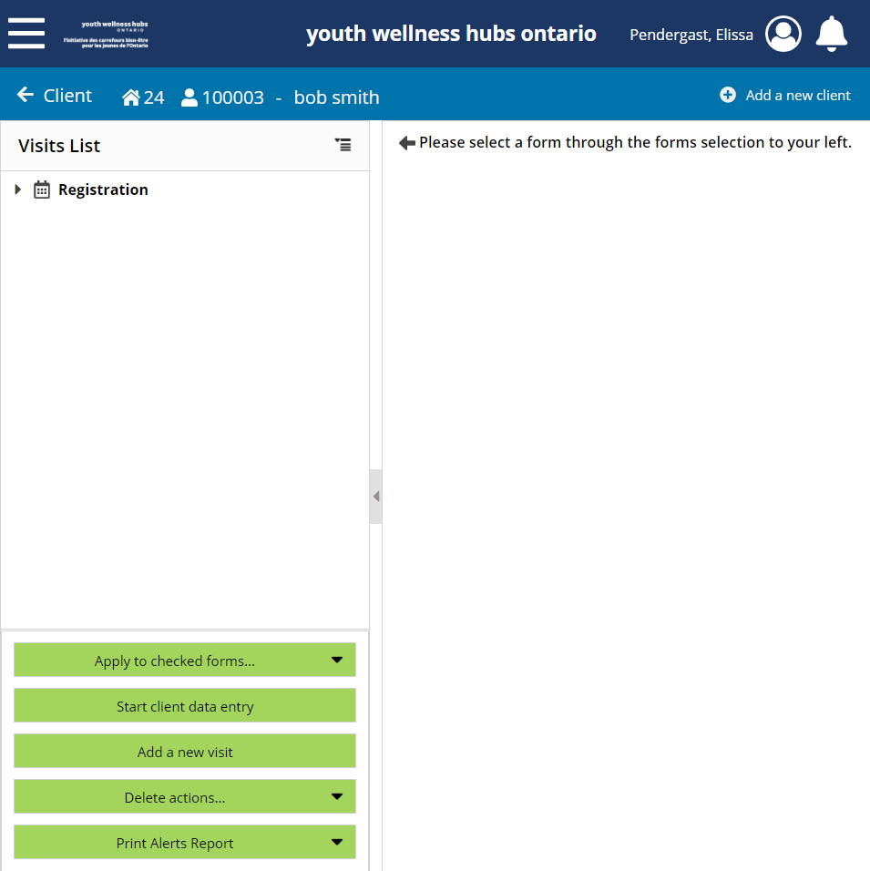
Start of Visit Forms
Currently in MWP, to access the Start of Visit Form for that visit, you must first:
  Add a New visit

Slide 52
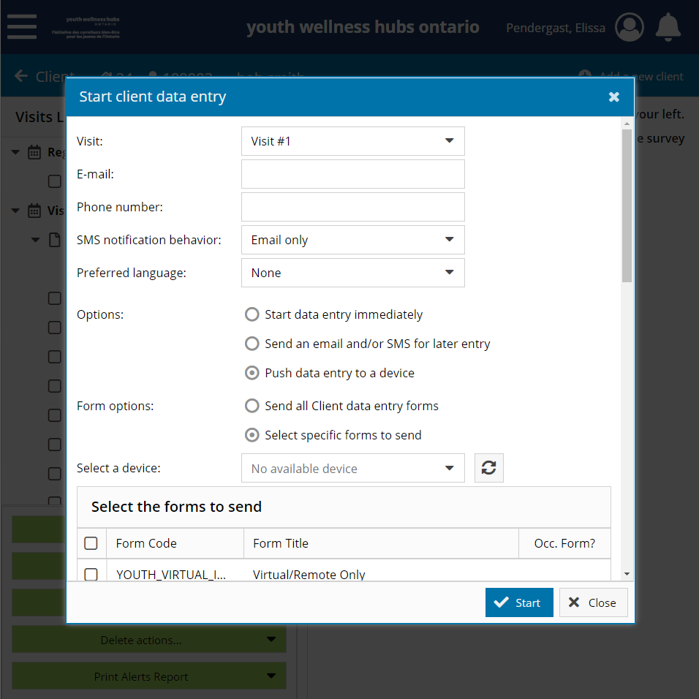
Start of Visit Forms
Currently in MWP, to access the Start of Visit Form for that visit, you must first:
  Add a New visit
  Close the “Start client data entry” pop-up

Slide 53
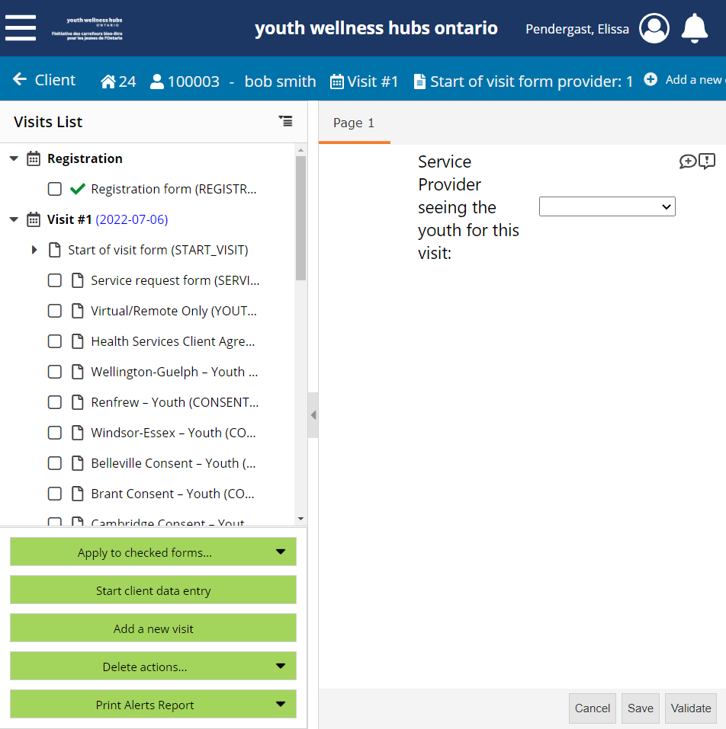
Start of Visit Forms
Currently in MWP, to access the Start of Visit Form for that visit, you must first:
  Add a New visit
  Close the “Start client data entry” pop-up
  Select the appropriate Service Provider seeing the youth
  Select Validate

Slide 54
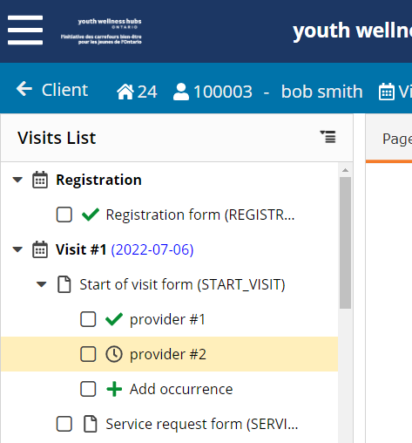
Start of Visit Forms
Please only add one occurrence for one provider.
  If multiples occurrences of the same provider exist, we will ask you to delete one of them
  If multiple occurrences exist and one of them is blank, please delete the second one

Slide 55
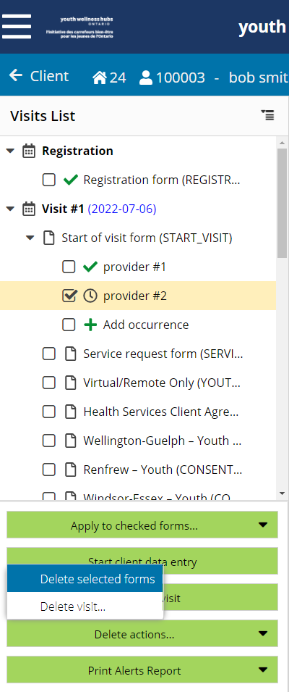
Start of Visit Forms
To delete an occurrence, select the occurrence you want to delete

Slide 56
Start of Visit Forms
To delete an occurrence, select the occurrence you want to delete
Click on “Delete actions…” and then “Delete selected forms”

Slide 57
Start of Visit Forms
Once you delete a form or visit, you cannot retrieve this information again in My Wellness Passport
The data will be permanently deleted, so ensure you are selecting the correct client and/or forms

Slide 58
Improving Data Quality
End of Visit Form – “Other” field
Test Clients
Blank Visits
Empty DOBs
Missing Start of Visit Forms
Missing Service Request Forms

Slide 59
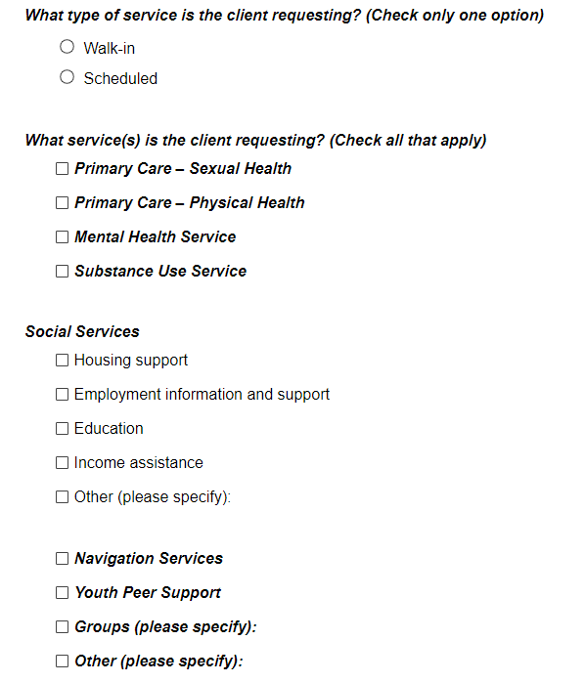
Service Request Forms
Once you have completed the Start of Visit Form, the next step is to complete the Service Request Form

Slide 60
Improving Data Quality
End of Visit Form – “Other” field
Test Clients
Blank Visits
Empty DOBs
Missing Start of Visit Forms
Missing Service Request Forms
Missing End of Visit Forms

Slide 61
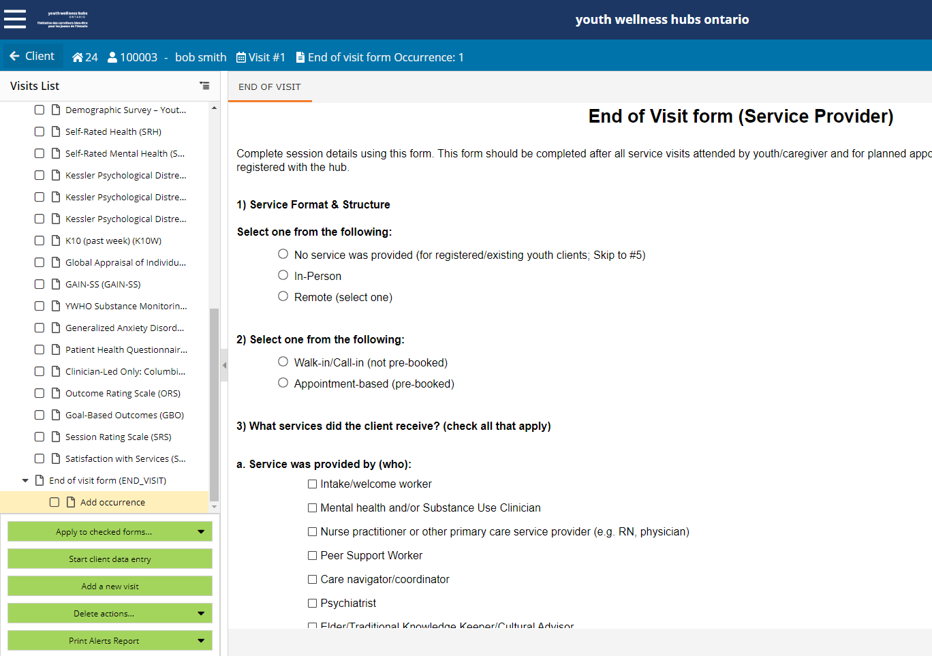
End of Visit Forms
There are two ways to be notified if an End of Visit form has not been completed:

Slide 62
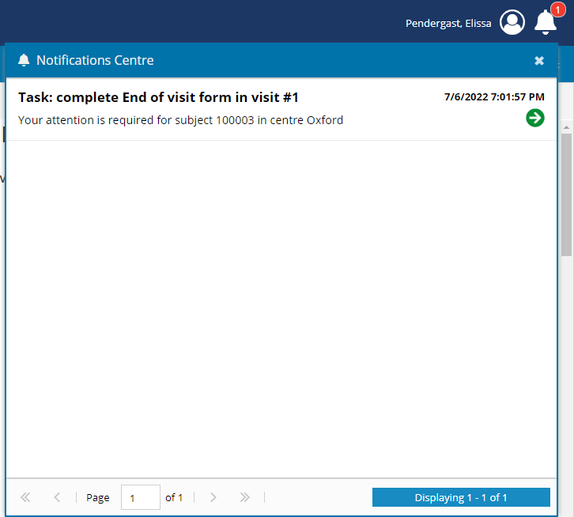
End of Visit Forms
There are two ways to be notified if an End of Visit form has not been completed:
  You will notice the alert icon in the top right corner when you log into your MWP account

Slide 63
End of Visit Forms
There are two ways to be notified if an End of Visit form has not been completed:
  You will notice the alert icon in the top right corner when you log into your MWP account
    Simply double click on the Task you wish to complete

Slide 64
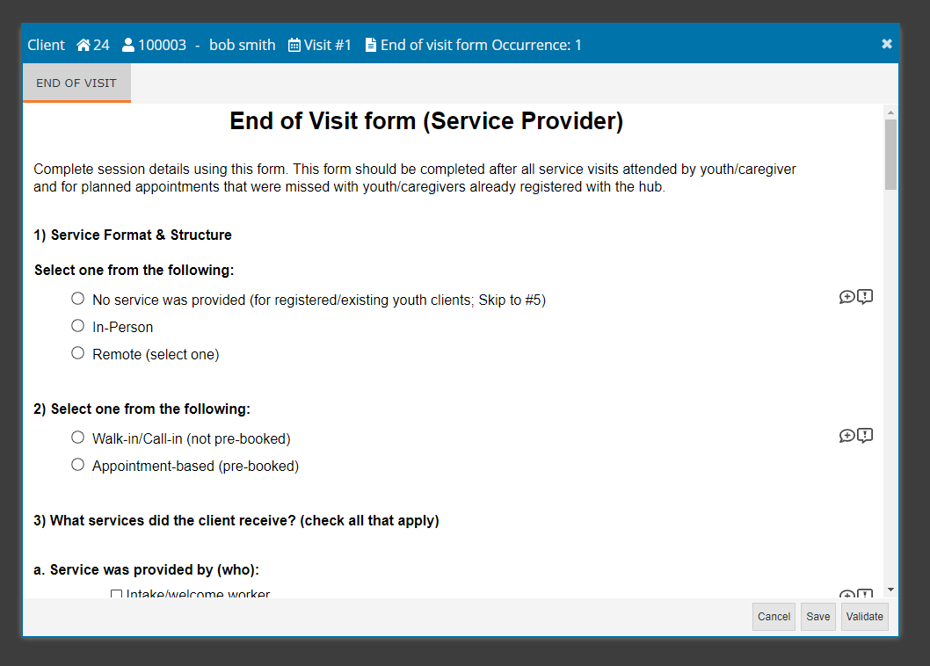
End of Visit Forms
There are two ways to be notified if an End of Visit form has not been completed:
  You will notice the alert icon in the top right corner when you log into your MWP account
    Simply double click on the Task you wish to complete
    A pop-up of the exact EOV form you need to complete will appear

Slide 65
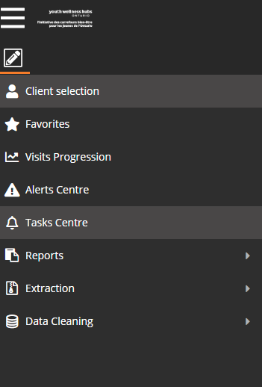
End of Visit Forms
There are two ways to be notified if an End of Visit form has not been completed:
  The Task Centre

Slide 66
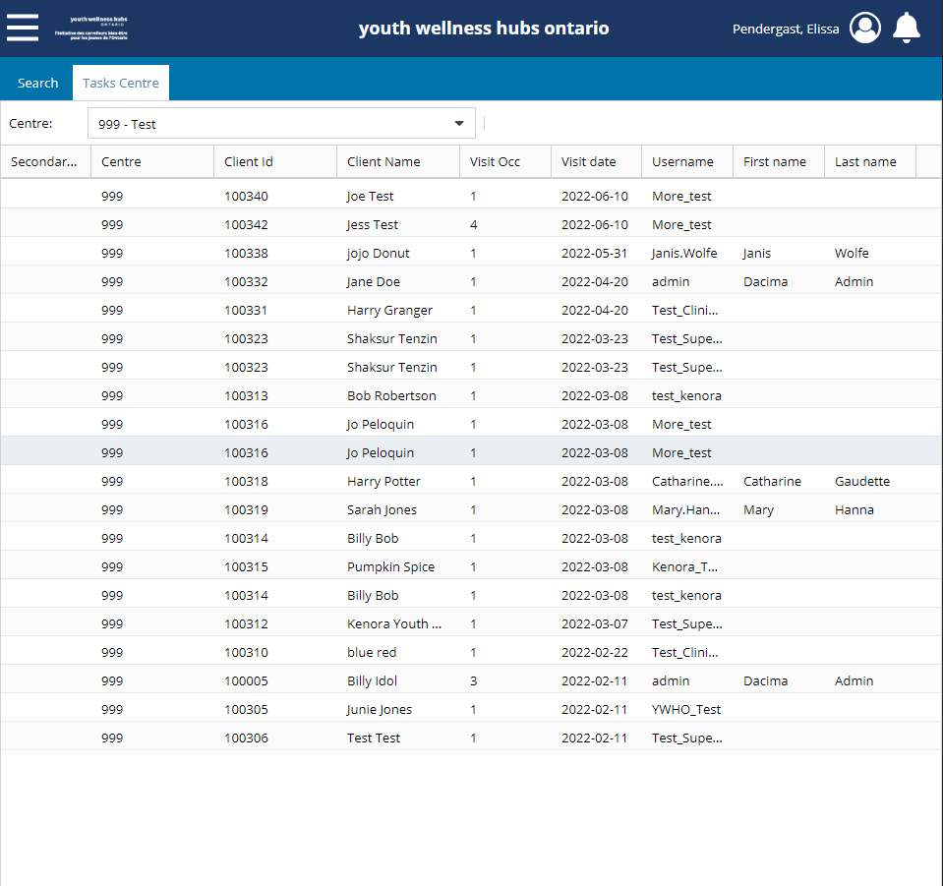
End of Visit Forms
There are two ways to be notified if an End of Visit form has not been completed:
  The Task Centre

Slide 67
End of Visit Forms
There are two ways to be notified if an End of Visit form has not been completed:
  The Task Centre
    Simply double click on the row you wish to complete
    A pop-up of the exact EOV form you need to complete will appear

Slide 68

Common MWP Errors
Multiple:
  Start of Visit Forms

Slide 69
Multiple SOVs
If two separate services are provided the same day to the youth, two occurrences of the Start of Visit in the same visit should not occur

Slide 70
Multiple SOVs
If two separate services are provided the same day to the youth, two occurrences of the Start of Visit in the same visit should not occur

Slide 71
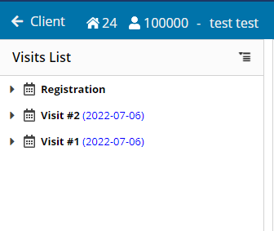
Multiple SOVs
Instead, create two separate visits:

Slide 72
Multiple SOVs
Instead, create two separate visits:
  The youth should only fill the Minimum Data Set once each day

Slide 73
Multiple SOVs
Instead, create two separate visits:
  The youth should only fill the Minimum Data Set once each day
  Exception, the youth would fill in:
    Session Rating Scales

Slide 74
Multiple SOVs
Instead, create two separate visits:
  For each visit., ensure the following forms are completed in each visit:
    Start of Visit Form
    Service Request Form
    End of Visit Form

Slide 75
Common MWP Errors
Multiple:
  Start of Visit Forms
  End of Visit Forms

Slide 76
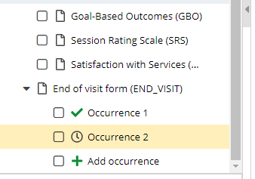
Multiple EOVs
If two separate services are provided the same day to the youth, two occurrences of the End of Visit in the same visit should not occur
Notes:
Talk about task centre

Slide 77
Multiple EOVs
If two separate services are provided the same day to the youth, two occurrences of the End of Visit in the same visit should not occur

Slide 78
Multiple EOVs
Instead, create two separate visits:

Slide 79
Multiple EOVs
Instead, create two separate visits:
  The youth should only fill the Minimum Data Set once each day

Slide 80
Multiple EOVs
Instead, create two separate visits:
  The youth should only fill the Minimum Data Set once each day
  Exception, the youth would fill in:
    Session Rating Scales

Slide 81
Multiple EOVs
Instead, create two separate visits:
  For each visit, ensure the following forms are completed by the provider:
    Start of Visit Form
    Service Request Form
    End of Visit Form

Slide 82

Thank
You!

Slide 83

Questions?

Slide 84





Connect with YWHO
@ywhontario
@ywhontario
@ywhontario
youthhubs.ca

