Slide 1

Gender Inclusion in Action: Providing Affirming Care to Trans Youth
Presented by Jack Lewis and Fae Johnstone
Notes:
Nakita – 3 mins

Slide 2


Fae Johnstone (They/She)
  Trans and LGBTQ2S+ educator, consultant and writer
  Background in CYMH and SRHR
  Senior Associate of Engagement and Mobilization with Wisdom2Action
Jack Lewis (He/Him)
  Bi-racial trans identified individual
  LGBTQ2S+ POC advocate and community educator
  Peer Support Worker at LGBT Youthline
Notes:
Fae – 1min
Jack – 1 min

Slide 3
Land Acknowledgements
Notes:
1min

Slide 4
Who’s joining us?
* A U D I E N C E P O L L *
Notes:
Fae – 1min

Slide 5
Webinar Objectives
Identify terminology and concepts related to gender identity
Describe elements of trans-affirming care through an intersectional lens
Understand challenges and barriers faced by trans individuals when accessing mental health and social services
Identify specific practices needed to create a trans-inclusive care setting within YWHO context
Appreciate the rich experience and knowledge young trans and gender non-conforming people possess in understanding and prioritizing their needs in affirmative care
Notes:
1min
5

Slide 6
1
2
3
4
5
Gender 101
  Setting the stage
Gender-Affirming & Trans-Inclusive Care
  Why does it matter?
Context
  Trans Youth in Ontario
Theory to Practice
  Accessing social services
YWHO Context
  Followed by Q&A
Notes:
Jack – 2min

Slide 7
Gender 101
1

Slide 8
Let’s talk about gender…
What does gender mean to you?
Word submission/discussion

Slide 9
Gender – an introduction
Gender is both socially constructed and deeply personal
Gender shapes how we interact with the world around us every day
Gender is thought of as a system of two – a binary
In truth, gender has never been a fixed, stable system. It changes every day, and is different in different communities and cultures around the world
Notes:
1-2mins

Slide 10
Trans is an umbrella term that refers to someone who identifies with a gender different from the gender they were assigned at birth
Trans includes people who identify as trans men and trans women, but also people who identify as non-binary, genderqueer, two spirit, and so much more!
So… where do trans people fit in?
Notes:
1min

Slide 11
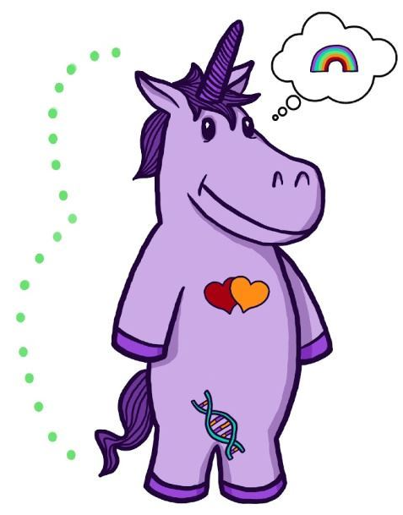
Breaking it down – gender identity & expression
What is gender identity?
What is gender expression?
Where do biology and sexuality fit in?
Notes:
2-3mins

Slide 12
Important terminology
Trans(gender)
Cis(gender)
Non-binary
Two Spirit
Intersex
Notes:
Jack 2 mins
Fae – 2mins
At 15 mins here.

Slide 13
What’s in a word? Transitioning and transness
We make a lot of assumptions about trans people and trans bodies
We put a lot of stereotypes on trans people in terms of the journeys and transitions we go through.
So what’s in a transition?
It depends on the person
There is no cookie-cutter transition
Everyone’s transition goals or needs are different
Notes:
1-2min

Slide 14
Debunking common misconceptions!
All trans people have surgeries and go on hormones
Many do, and many don’t, for varying reasons.
All trans men are very masculine, all trans women are very feminine, and all genderqueer people are completely androgynous
The femininity, masculinity, and androgyny of trans people can vary widely, as much as it varies in cisgender people.
Trans people all share a particular value system… share a political ideology… share a certain set of ideas about gender
Everyone experiences life differently; therefore their value systems are shaped differently.
Notes:
2 mins

Slide 15
Gender-affirming & trans-inclusive care
2
Notes:
18mins.

Slide 16
Why does gender-affirming and trans-inclusive care matter?
Trans youth experience higher rates of suicidality, mental health problems, substance abuse and homelessness
Trans people’s lives are shaped by the violence of transphobia
Notes:
1min

Slide 17
It’s based on the following principles:
Gender-affirming care principles
Gender-affirming care is the gold standard in inclusive, evidence-based care for trans and gender diverse children, youth, and their families, founded by Dr. Diane Ehrensaft.
  Transgender identities and diverse gender expressions do not constitute a mental disorder
  Variations in gender identity and expression are normal aspects of human diversity, and binary definitions of gender do not always reflect emerging gender identities
  Gender identity evolves as an interplay of biology, development, socialization, and culture
  If a mental health issue exists, it most often stems from stigma and negative experiences rather than being intrinsic to the child.
Notes:
3min

Slide 18
Intersectionality
Coined by Dr. Kimberlé Crenshaw in 1989
Notes:
5 mins

Slide 19
Ontario Context
3

Slide 20
Trans children and youth do not feel safe accessing health and social services.
One-third of younger (ages 14-18) and half of older youth (ages 19-25) reported missing needed physical health care during the past year, and even more missed needed mental health care
52% of trans people in Ontario who have accessed an emergency room have had a negative experience doing so
21% of trans people in Ontario have avoided accessing emergency rooms when needed due to fear of negative treatment
Source: SARAYVC & TransPulse Project
Notes:
2mins
25mins

Slide 21
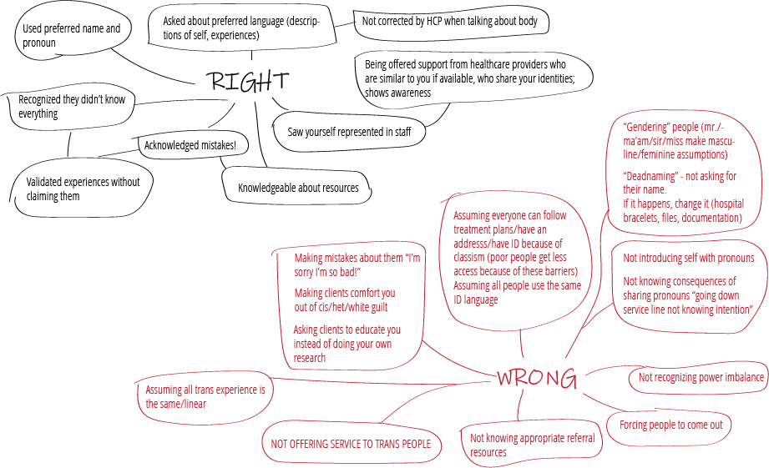
Notes:
2-3mins

Slide 22
From theory to practice
4

Slide 23
Gender inclusive care - from theory to practice
At the end of the day, trans affirming care is:
  Meeting people where they’re at
  Avoiding imposing your ideas onto others
  Acknowledging the client as the expert in their own identities and experiences
  Shaping the care around the needs of our clients (individualized approach to care)
Notes:
1min

Slide 24
Why pronouns matter
How to implement them in your practice
Putting into Practice: Pronouns
Provide opportunities for disclosure
Don’t force pronoun disclosure
Practice and normalize
Putting into Practice: Confidentiality & Privacy
Someone’s trans identity is absolutely confidential information unless you are specifically told otherwise.
Notes:
3mins

Slide 25
Putting into Practice: Mirror how we describe ourselves
  Trans people describe our identities and experiences in all kinds of ways
  While there are ‘best practices’ around the most inclusive language, individuals have every right to describe themselves with whatever language works best for them
  The best way to respect and affirm every individual is by mirroring the language they use to describe themselves
Notes:
1min

Slide 26
Yes, you will make mistakes
  No, that doesn’t make you a bad person
  Yes, it hurts us and we might respond with that in mind
  No, that’s not an inappropriate response
  Yes, we want you to move on
  No, it’s not about you
  Yes, you can learn and improve
Notes:
2-3mins

Slide 27
Building blocks of trans competent care
If we can acknowledge that trans communities are incredibly diverse, we must also acknowledge that there is no workshop, no language guide, that will perfectly equip providers to support such a diverse population
This webinar is about giving you a framework and some practical insights into supporting trans communities and clients
Notes:
1min

Slide 28
Moving into the
YWHO Context
5

Slide 29
Intake
Setting a stage of inclusivity from the very first moment a young person walks in the door is exceptionally important. First impressions make all the difference, and present an opportunity to build trust from the very moment of contact.
  Respect Pronouns
  Chosen name vs legal name
  Privacy of information
How can we build that trust, as soon as someone walks through the door?
  Diverse staff teams
  Rainbow stickers, posters, etc.
  Warm hello
The Intake Process
Notes:
2mins

Slide 30
Why do these questions matter?
What name do you go by?
What pronouns do you identify with/go by? (she/her, he/him, they/them, etc.)?
Please tell us where you are living. Please check all that apply.
How do you describe your gender identity? Check all that apply.
How do you describe your sexual identity?
Socio-demographic data
Notes:
3mins

Slide 31
Clinical visit: Mental health services
Yes, trans people experience higher rates of mental health problems. No, that is not intrinsically linked to their trans identity. The realities of violence, oppression and violence impacting trans people lead to a greater prevalence of mental health problems.
Transness =/= a mental health problem.
History of pathologization etc…
Don’t make assumptions based on appearance, listen to the young person, what they need, and how they describe themselves.
Notes:
2mins

Slide 32
Clinical Visit: Primary Care
Just like everyone else, trans people often need access to primary care, which may or may not have anything to do with their gender identity or expression.
Understand that, just like everyone, trans bodies are incredibly diverse. We all use different language to describe our bodies, and we all have bodies that work in different ways. Ask young people how to best describe their body parts.
Physicals: get explicit informed consent before invasive procedures like physicals or touching people’s bodies. Just ask.
Hormones: nurse practitioners can prescribe hormones, administer hormone dosages and any documentation needed for physical care outside of surgery
Referral letters for Gender Affirming Surgery (GAS): nurse practitioners can be one of two letters for surgical referrals for bottom surgery. For top surgery, only one letter is required and nurse practitioners can provide this letter and refer independently.
Notes:
3mins

Slide 33
Follow-up:
What does follow up looks like through an inclusive lens?
Consistency and intentionality is important to ensure trans inclusive care
i.e. ensuring the correct name and pronouns are being used when contacted for follow-up
Notes:
1min

Slide 34
20-40% of homeless youth are LGBTQ2+ identified
LGBTQ2+ youth are less likely to feel safe in shelters and traditional housing environments
If someone is accessing your services, it’s because that is the service they feel safest accessing
As a housing worker, one should think about:
Non-clinical service: Housing
How to support a trans young person who experiences violence in public with you, or while accompanying them to visit a landlord or to an appointment
Being honest about the realities of shelters, and other housing or gendered services (this is the way this looks and how can we support you to navigate a space that isn’t 100% okay)
Letting clients guide decisions about accessing gendered services.
Notes:
3mins

Slide 35
Non-clinical service: Employment
50% of trans people in Ontario make under 15,000$/year
Many trans young people have experienced employment discrimination and hostile work environments
22% of trans people of colour have been turned down for a job due to their race/ethnicity (TransPulse, 2010)
Trans people are often segued into jobs such as this, where they are educating others on their identities
When you are an employment counsellor working with trans youth it is important to recognize these systemic barriers

Slide 36
Takeaways
Use language that does not reduce youth to one aspect of their existence
Be mindful of young people that are hearing messages you use when discussing them
Craft intervention strategies that take into account the varied experiences young trans people face
Find ways to build upon the strength of gender non-conforming and trans youth in programs and in public facing campaigns
Recognize that race silent is not race neutral. Name youth of colour as the most impacted when talking about trans youth experiences.
Adapted from True Colors United

Slide 37
Resources
Rainbow Health Ontario (RHO): https://www.rainbowhealthontario.ca/trans-health/
  Trans Care Mentorship Call (weekly on Wednesdays, 12-1pm): an opportunity for clinicians across the province to join a weekly teleconference and connect with other clinicians who have experience working with trans and non-binary clients.
LGBT Youth Line: https://www.youthline.ca/
Youth and Family Experiences at the CHEO Gender Diversity Clinic, January 2019: http://files.basekit.com/62/28/6228c248-55bf-49ed-ad13-1df44c56fab4.pdf
Sherbourne Health: Guidelines and Protocols for Hormone Therapy and Primary Care for Trans Clients: http://sherbourne.on.ca/wp-content/uploads/2014/02/Guidelines-and-Protocols-for-Comprehensive-Primary-Care-for-Trans-Clients-2015.pdf
TransLine – Free online medical consultation offering healthcare providers clinical information and individualized case consultation service, http://project-health org/transline/

Slide 38
Trans Youth are Brilliant, Resilient and Valuable

Slide 39
Questions?

Slide 40
Following this webinar, reflect on three concrete actions you can take in your work and practice to support and affirm trans and gender diverse youth.
Please click the following link to fill out the short survey to let us know how we did and what else you might want to learn!

